Slide 2
Computer Networking
Lesson #2
Transmission media
By: Suresh Khanal
For http://mcqSets.com

Slide 3
Topics:
What is transmission media
Types of transmission media
Bound transmission media
Unbound transmission media

Slide 4
What is transmission media

Slide 5
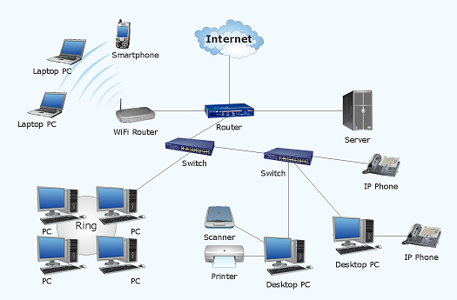
Transmission media is the pathway through which data travels in a network. It can be guided as in cables or wires and also unguided transmission media such as in wireless transmission.

Slide 6
Cables used to connect the different nodes of network are also called bound transmission media as they are bound by physical geography.

Slide 7
Thus, for wireless connections, that are not bound by physical geography are called unbound transmission media

Slide 8
Types of transmission media

Slide 9
Types of transmission media
Bound transmission media or Guided transmission media
Twisted Pair Cables
Co-axial Cables
Fibre Optics Cable
Unbound transmission media or Unguided transmission media
Microwave
Radiowave
Infrared

Slide 10
1. Bound transmission media

Slide 11
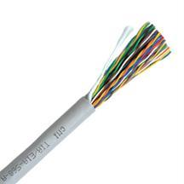
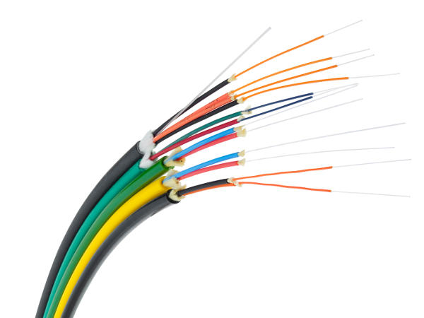
Bound Transmission media
The type of media that is bound by physical geography such as cables are known as bound transmission media. Twisted pair cables, Co-axial cables, Fibre optics cables etc. are the examples.

Slide 12
1.1 Twisted Pair Cables

Slide 13
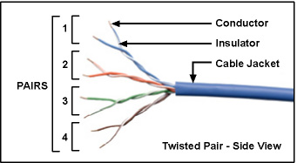
Twisted Pair Cables
A pair of wires twisted with each other. The conductor (copper) is cover with insulator and 4 pairs of such are packed inside cable jacket to make a network cable.

Slide 14
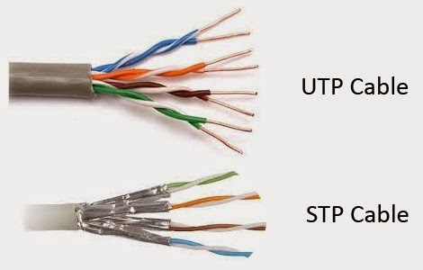
Twisted Pair Cables

Slide 15
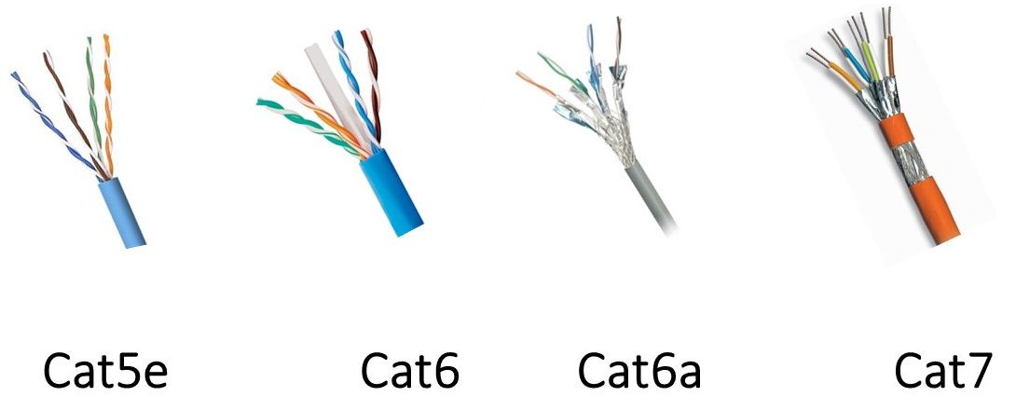
Different category Twisted Pair Cables
https://www.linkedin.com/pulse/guide-choosing-suitable-ethernet-cables-kerry-zhang

Slide 16
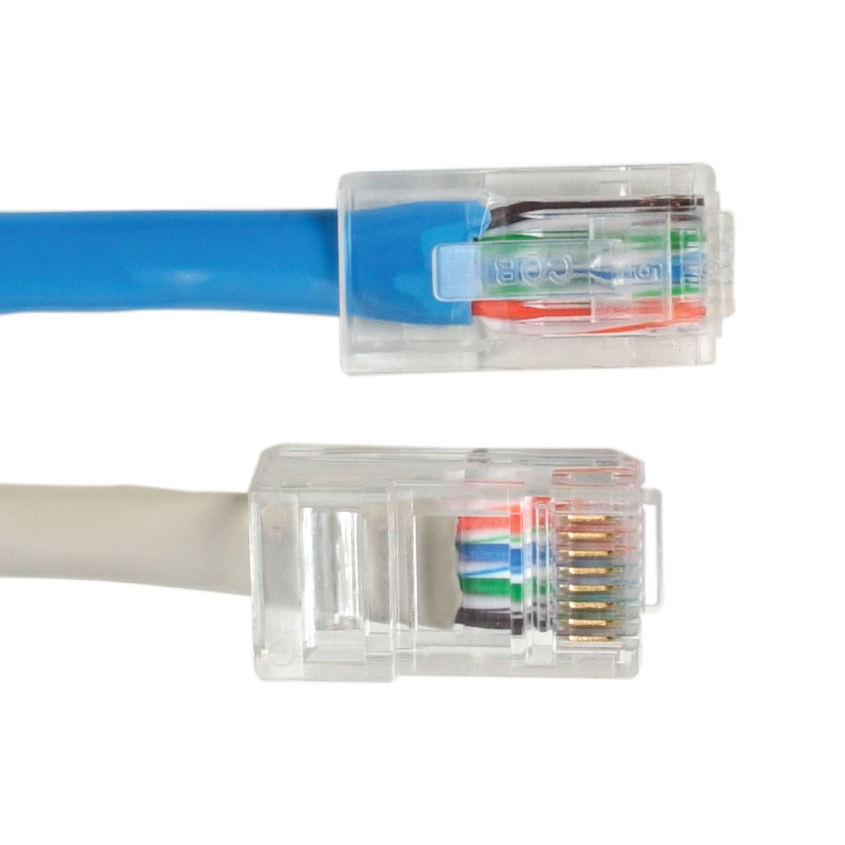
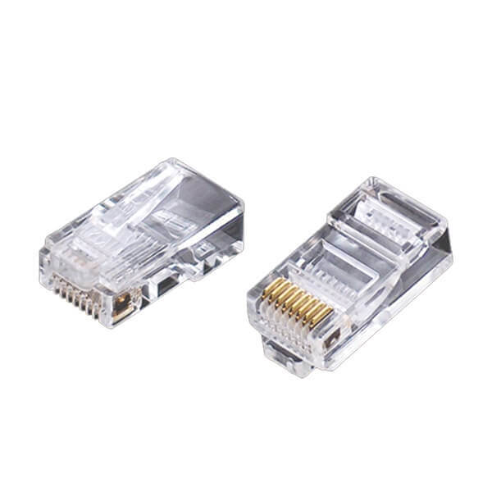
RJ45 for Twisted Pair Cables
https://www.linkedin.com/pulse/guide-choosing-suitable-ethernet-cables-kerry-zhang

Slide 17
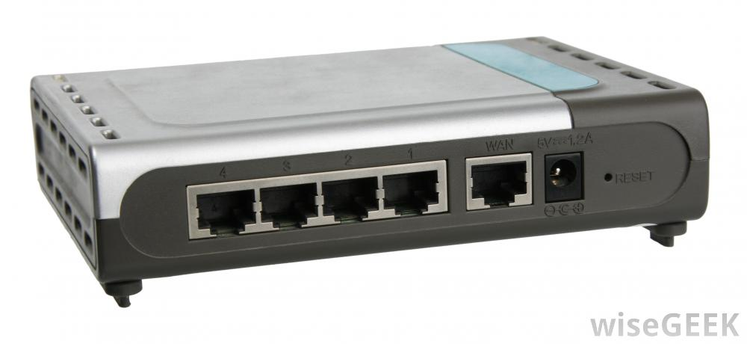
RJ45 Ports

Slide 18
Types of transmission media
Bound transmission media or Guided transmission media
Twisted Pair Cables
Co-axial Cables
Fibre Optics Cable
Unbound transmission media or Unguided transmission media
Microwave
Radiowave
Infrared

Slide 19
1.2 Co-Axial Cables

Slide 20
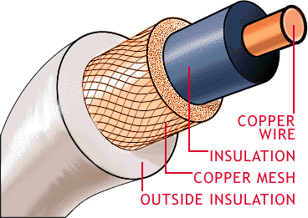
Co-Axial Cable
A solid central conductor surrounded by insulating material and then by a cylindrical shield woven from fine wires is known as co-axial cable.

Slide 21
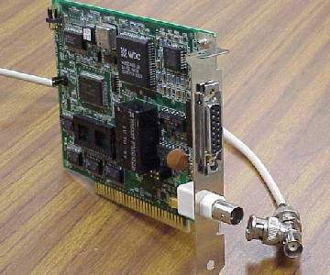
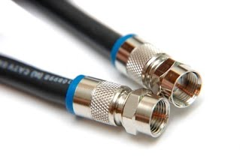
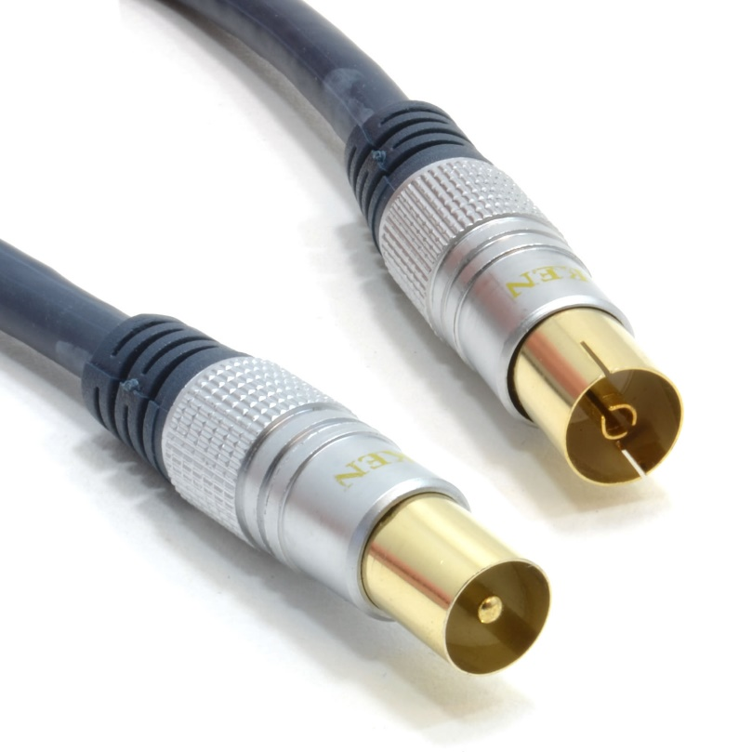
Co-Axial Cable
Co-axial cables are terminated with a connector known as BNC connector

Slide 22
1.3 Fiber-Optics cable

Slide 23
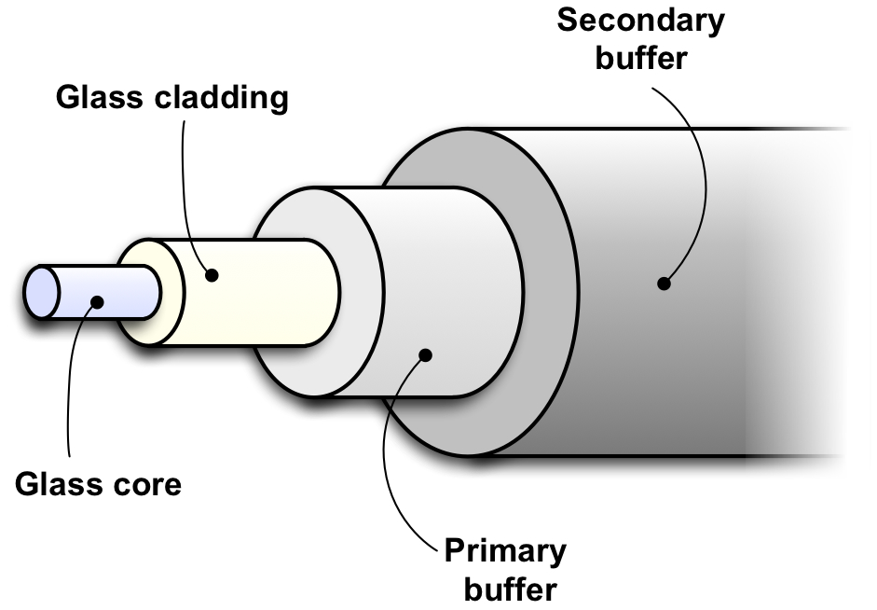
Fiber-Optics cable
A cable with central glass tube covered with protective shield which transmit data using photons is fiber optics cable. These cables transmit data via concentrated bursts of laser beams which are carried through bundles of hair thin glass fibers.

Slide 24
Fiber-Optics cable
A cable with central glass tube covered with protective shield which transmit data using photons is fiber optics cable. These cables transmit data via concentrated bursts of laser beams which are carried through bundles of hair thin glass fibers.

Slide 25
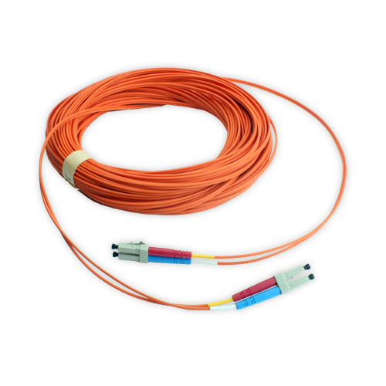
Fiber-Optics cable
Physical look of fiber optic cable terminated with SC connector

Slide 26
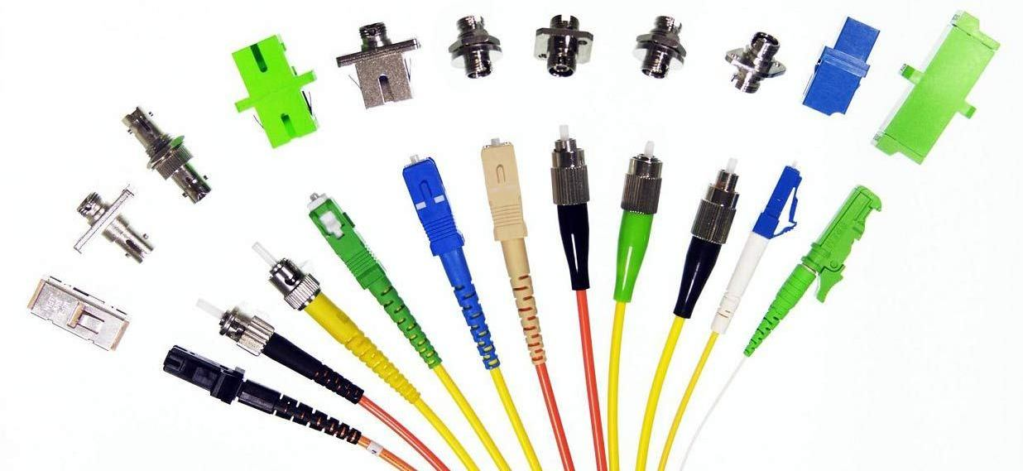
Fiber-Optics cable Connectors

Slide 27
Types of transmission media
Bound transmission media or Guided transmission media
Twisted Pair Cables
Co-axial Cables
Fibre Optics Cable
Unbound transmission media or Unguided transmission media
Microwave
Radiowave
Infrared

Slide 28
2. Unbound Transmission Media

Slide 29
Unbound Transmission Media
Unbound transmission media extend beyond the limiting confines of cabling.
They provide an excellent communication alternative for WANS. The lack of physical restrictions provides larger bandwidth as well as wide area capabilities. Unbound media typically operate at very high frequencies.
The three types of unbound transmission media are: Radio wave, Micro wave, Infrared

Slide 30
Radio Wave
Radio waves makes it possible to connect to the network when running cables is difficult or more expensive.
In wireless networking, air is the vehicle through which the data is carried, just as Ethernet uses copper cable

Slide 31
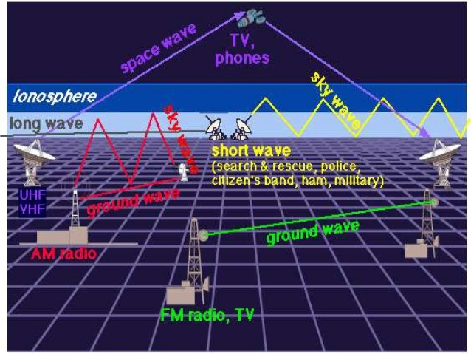
Radio Wave
Credits: https://www.slideshare.net/SameerFarooq2/sameer-farooq

Slide 32
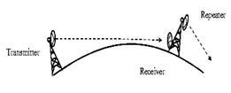
Microwave
Microwaves have been used in data communications for a long time. They have a higher frequency than radio waves and therefore can handle larger amounts of data.
Microwave transmission is line of sight (LOS) transmission. The transmit station must be in visible contact with the receive station. This sets a limit on the distance between stations depending on the local geography. Typically the line of sight, due to the Earth’s curvature, is only 50 km to the horizon! Repeater stations must be placed so the data signal can hop, skip and jump across the country.

Slide 33
Infrared
Infrared offers a great unbound photonic solution. Like fiber-optic cabling, infrared communications use light, so they are not bound by the limitations of electricity.

Slide 34
Thank You

