Slide 2
Computer Networking
Lesson #1
Definition, DIS/Advantages & Services
By: Suresh Khanal
For http://mcqSets.com

Slide 3
Topics:
Definition of Computer Networking
Advantages & Disadvantages of Computer Networking
Network Services

Slide 4
Definition

Slide 5
Definition
Computer Network is a collection of distributed intelligent machines that are connected with each other with transmission media for the purpose of data sharing, communication and sharing of computer resources.

Slide 6
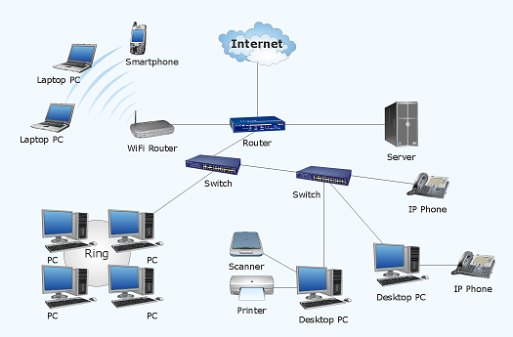
Computer Network is a collection of distributed intelligent machines that are connected with each other with transmission media for the purpose of data sharing, communication and sharing of computer resources.

Slide 7
Definition
Computer Network is a collection of distributed intelligent machines that are connected with each other with transmission media for the purpose of data sharing, communication and sharing of computer resources.

Slide 8
Advantages & Disadvantages of Computer Networking

Slide 9
Advantages of Computer Networking
Management - The computers, staff and information can be well managed
Accessibility - A network provides the means to exchange data among the computers and to make programs and data available to people
Resource Sharing - It permits the sharing of the resources of the machine
Backup - Networking also provides the function of back-up.
Flexible working environment - Networking provides a flexible working environment. Employees can work at home by using office computer through networks.

Slide 10
Advantages of Computer Networking
Sharing devices such as printers saves money.
Software licenses are likely to be cheaper than buying several standalone licenses.
Files can easily be shared between users.
Network users can communicate by email and instant messenger.
Security is good - users cannot see other users' files unlike on stand-alone machines.
Data is easy to backup as all the data is stored on the file server.

Slide 11
Disadvantages of Computer Networking
Purchasing the network cabling and file servers can be expensive.
Managing a large network is complicated, requires training and a network manager usually needs to be employed.
If the file server breaks down the files on the file server become inaccessible. Email might still work if it is on a separate server. The computers can still be used but are isolated.
Viruses can spread to other computers throughout a computer network.
There is a danger of hacking, particularly with wide area networks. Security procedures are needed to prevent such abuse, eg a firewall.

Slide 12
Network Services

Slide 13
Network Services
File Services: This includes file transfer, storage, data migration, file update, synchronization and achieving.
Printing Services: This service produces shared access to valuable printing devices.
Message Services: This service facilitates email, voice mails and coordinate object oriented applications.
Application Services: This services allows to centralize high profile applications to increase performance and scalability
Database Services: This involves coordination of distributed data and replication.

Slide 14
Thank You

